Slide 1
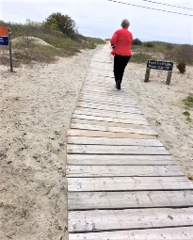
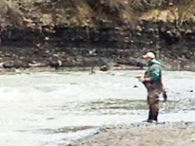
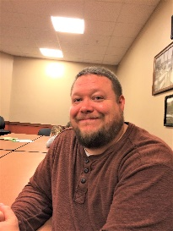
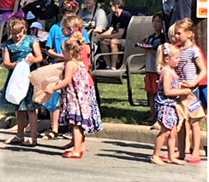
Going Fishing
Kim and Jill are going fishing. Mr. Hill
is going fishing with his girls Kim and

Slide 2
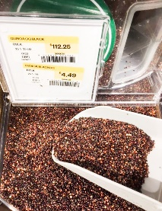
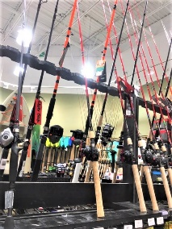
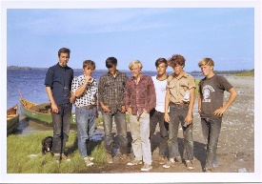
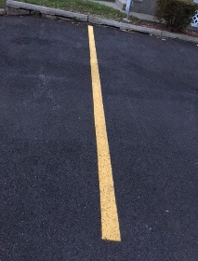
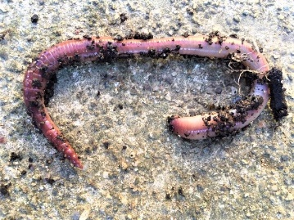
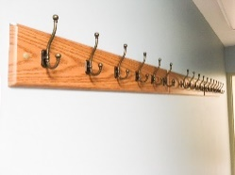
Jill. They get some poles. Kim and Jill
and Mr. Hill have some line and
some hooks. They get some worms.

Slide 3
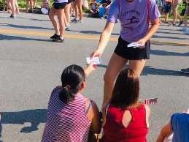
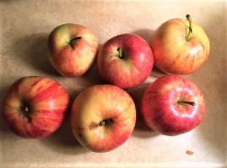
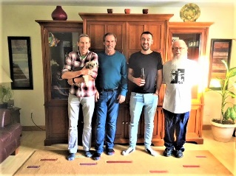
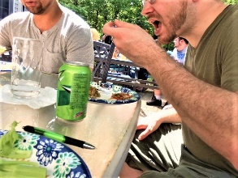
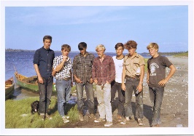
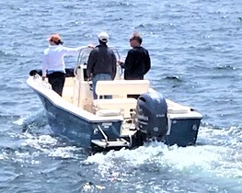
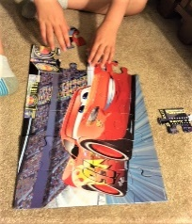
Kim and Jill and Mr. Hill take some
apples with them to eat. They get the
boat. Jill and Kim and Mr. Hill put the

Slide 4
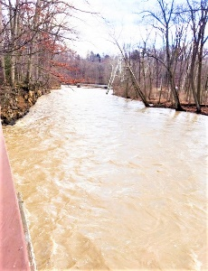
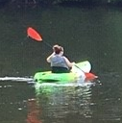
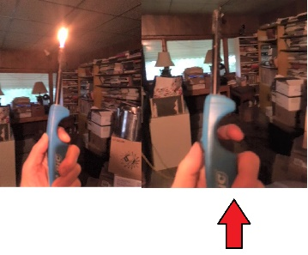
poles and worms and apples in the
boat. They put the boat in the river.
They row out into the river. They put

Slide 5
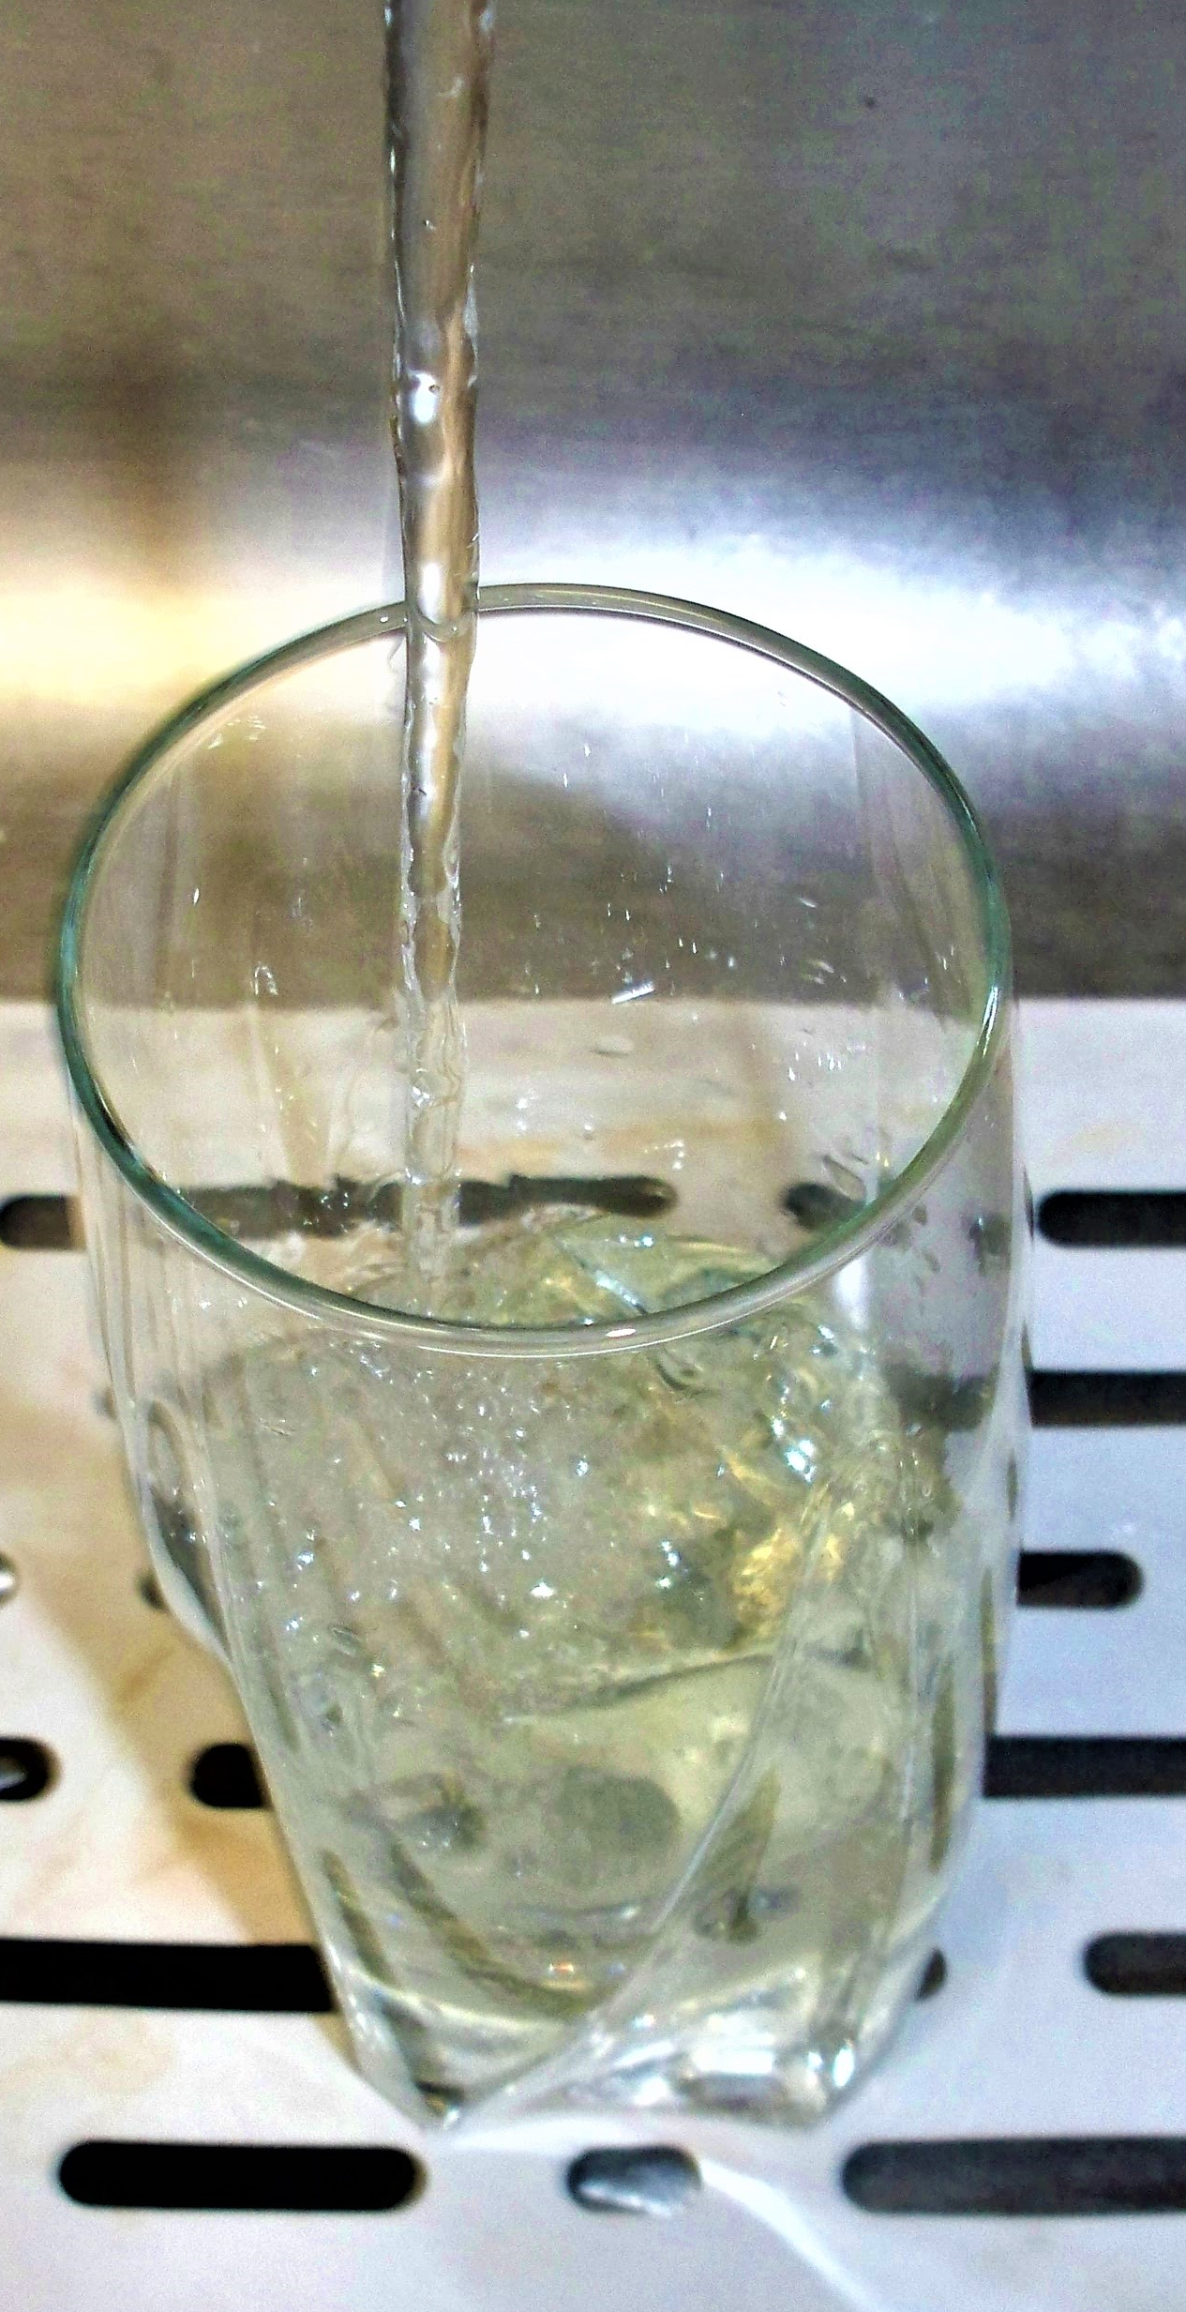
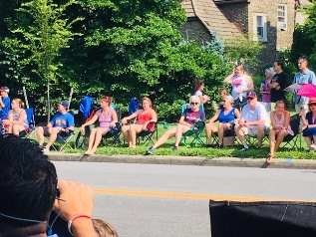
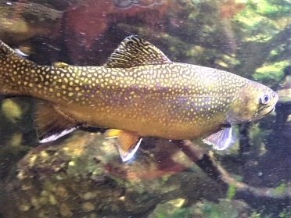
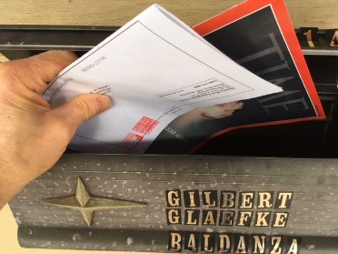
the worms onto the hooks. They put
the hooks in the water. They sit and
fish. They eat the apples. They get

Slide 6
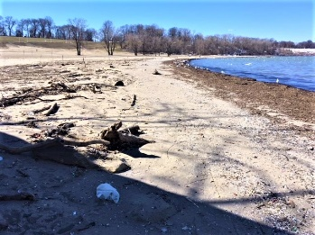
8
2
eight fish. Jill gets two fish. Kim gets
3
3
three fish. And Mr. Hill gets three fish.
Then they row to the beach. They get

Slide 7
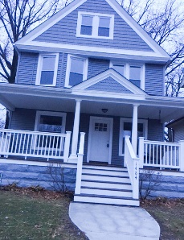
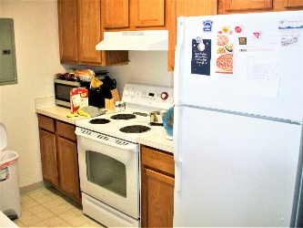
out of the boat. Mr. Hill and Jill and
Kim take the fish to the house. They
take the fish to the kitchen. They

Slide 8
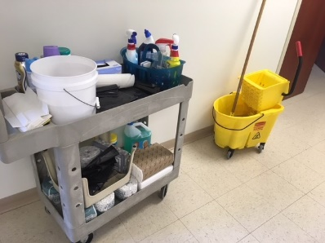
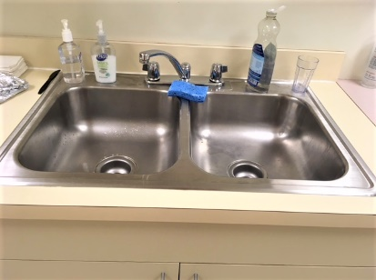
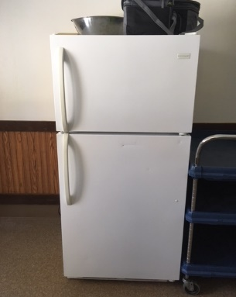
clean the fish in the kitchen at the
sink. Mr. Hill and Jill and Kim
put the fish in the refrigerator. At

Slide 9
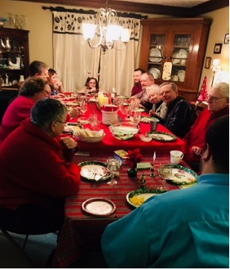
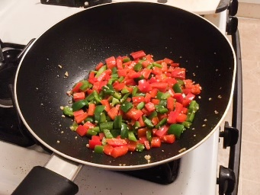
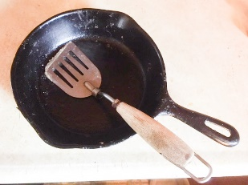
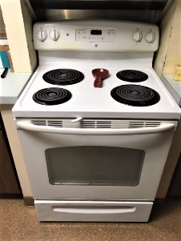
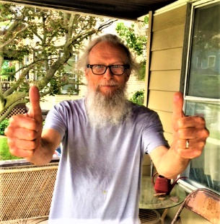
dinner they cook the fish in a pan on
the stove. The fish are good. The fish
Kim
are very good. Mr. Hill and Jill and

Slide 10
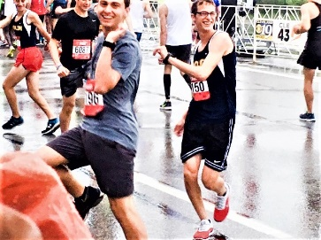
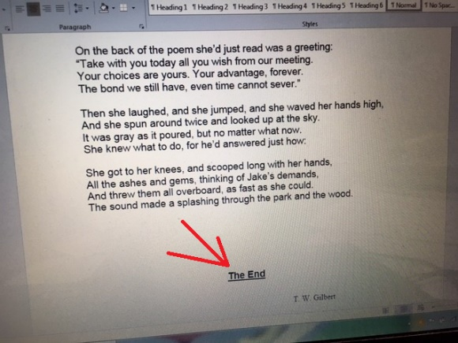
are very happy. They have a fish
dinner.
THE END

Slide 11
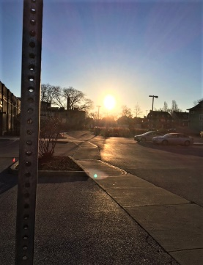
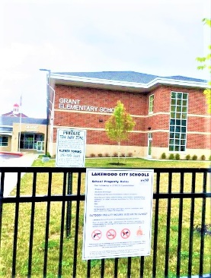
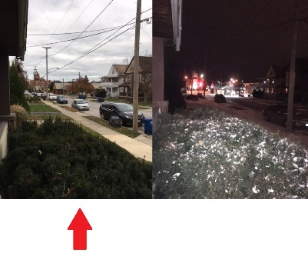
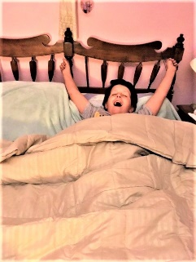
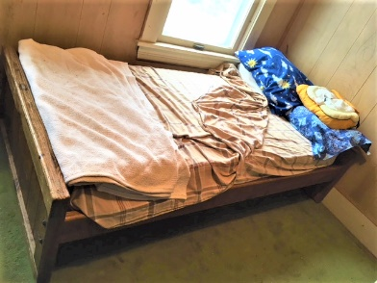
A Morning Day at School
Erin wakes up in the morning at 7:00.
She gets out of bed.

Slide 12
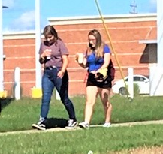
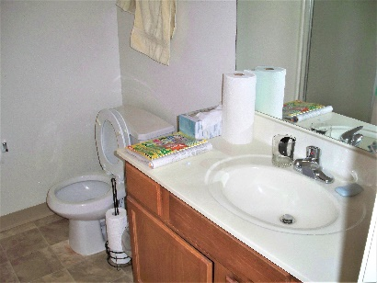
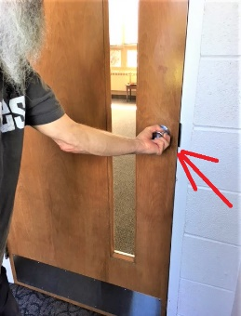
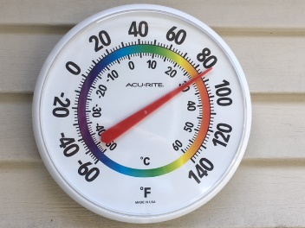
She walks to the bathroom.
She goes to the sink.
She turns on the hot water.

Slide 13
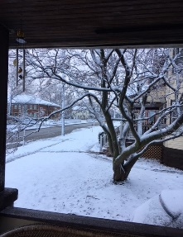
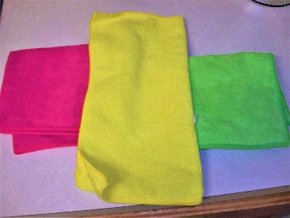
She turns on the cold water.
She gets a washcloth.
She puts the washcloth in the

Slide 14
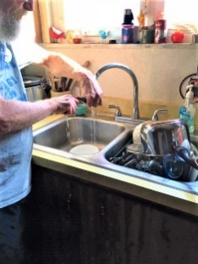
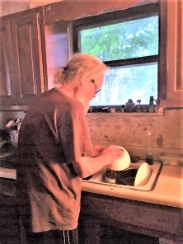
water.
She wrings out the
washcloth.
She washes her face with the
washcloth.
She turns off the water.

Slide 15
washcloth.
She wrings out the
She puts it on the rack on
the wall.
She goes back to her room.

Slide 16
She goes back to her room
and gets dressed.
Then she goes down stairs

Slide 17
to the kitchen.
Her mom and dad and brother are
in the kitchen.
Her mom and dad are fixing
breakfast.

Slide 18
Her brother Tim is sitting at the
kitchen table.
Her mom and dad are making

Slide 19
eggs and oatmeal.
oatmeal on the stove.
They are making eggs and
The eggs are in a pan.

Slide 20
The oatmeal is in a pot.
Erin sits down at her place at the
table.
cook.
She waits for the food to

Slide 21
oatmeal.
Her mom gives her a bowl of
Her dad gives her a fried egg on
a plate.
Erin says, “Thank you very much.”

Slide 22
Erin says, “Thank you very much,”
to her mom and dad.
They both say, “You

Slide 23
are very welcome.”
Erin eats her oatmeal with a
spoon.
Erin eats her egg with a fork.
Erin drinks her glass of orange
juice.

Slide 24
Erin also drinks her glass of milk.
8:00 o’clock.
When Erin is done eating, it is
She takes her plate and bowl

Slide 25
and glasses to the sink.
She takes her plate and bowl
washed.
and glasses to the sink to be

Slide 26
Erin goes to the den to get her
book bag.
She looks in her book bag.

Slide 27
She looks in her book bag
to make sure she has her
books and her homework.

Slide 28
She puts on her book bag.
Erin’s mom hands her the lunch
box.
Erin’s mom hands her the lunch

Slide 29
refrigerator.
box that she got out of the
“What’s for lunch?” Erin asks her
mom.
Erin’s mom says, “A ham and

Slide 30
cheese sandwich, an apple, some
chips, and a juice box. Is that O.K.?”
“Thanks, Mom,” says Erin.

Slide 31
When Erin gets to the door, she
waits for her brother Tim.
5
Tim gets to the door in five
minutes.

Slide 32
Erin and Tim yell to their mom and
dad, “We’re going to school, now.
See you later.”

Slide 33
Their mom and dad yell back,
“Have a good day.”
THE END

Slide 34
Shane
By Jack Schaefer
1
He rode into our valley in the summer of ’89. I was a kid then, barely topping the backboard of father’s old chuck wagon. I was on the upper rail of our small corral, soaking in the late afternoon sun, when I saw him far down the road where it swung into the valley from the open land beyond.

Slide 35
In that clear Wyoming air I could see him plainly, though he was still several miles away. There seemed nothing remarkable about him, just another stray horseman riding up the road toward the cluster of frame buildings that was our town. Then I saw a pair of cowhands, loping past him, stop and stare after him with a curious intentness.
He came steadily on, straight through the town without slackening pace, until he reached the fork a half-mile below our place. One branch turned left across the river ford and on to Lake Fletcher’s big spread. The other bore ahead along

Slide 36
the right bank where we homesteaders had pegged our claims in a row up the valley. He hesitated briefly, studying the choice, and moved again steadily on our side. As he came near, what impressed me first was his clothes. He wore dark trousers of some serge material tucked into tall boots and held at the waist by a wide belt, both of a soft black leather tooled in intricate design. A coat of the same dark material as the trousers was neatly folded and strapped to his saddle-roll. His shirt was finespun linen, rich brown in color. The handkerchief knotted loosely around his throat was black silk. His hat was not the familiar Stetson, not the familiar gray of muddy

Slide 37
tan. It was a plain black, soft in texture, unlike any hat I had ever seen, with a creased crown and a wide curling brim swept down in front to shield his face.
All trace of newness was long since gone from these things. The dust of distance was beaten into them. They were worn and stained and several neat patches showed on the shirt. Yet a kind of magnificence remained and with it a hint of men and manners alien to my limited boy’s experience.
Then I forgot the clothes in the impact of the man himself. He was not much above medium height, almost slight in build. He would have looked

Slide 38
limited boy’s experience.
Then I forgot the clothes in the impact of the man himself. He was not much above medium height, almost slight in build. He would have looked the hat’s brim. He came closer, and I could see that this was because the brows were drawn in a frown of fixed and habitual alertness. Beneath them the eyes were endlessly searching from side to side and forward, checking off every item in view, missing nothing. As I noticed this, a sudden chill, I could not have told why, struck through me there in the warm and open sun.

Slide 39
He rode easily, relaxed in the saddle, leaning his weight lazily into the stirrups. Yet even in this easiness was a suggestion of tension. It was the easiness of a coiled spring, of a set trap.
He drew rein not twenty feet from me. His glance hit me, dismissed me, flicked over our place. This was not much, if you were thinking in terms of size and scope. But what there was was good. You could trust father for that. The corral, big enough for about thirty head if you crowded them in, was railed right to

Slide 40
true sunk posts. The pasture behind, taking in nearly half our claim, was fenced tight. The barn was small, but it was solid, and we were raising a loft at one end for the alfalfa growing green in the north forty. We had a fair-sized field in potatoes that year and father was trying a new corn he had sent all the way to Washington for and they were showing properly in weedless rows.

Slide 41
TREASURE ISLAND
PART ONE—The Old Buccaneer
1
The Old Sea-dog at the "Admiral Benbow"
SQUIRE TRELAWNEY, Dr. Livesey, and the rest of these gentlemen having asked me to write down the whole particulars about Treasure Island, from the beginning to the end, keeping nothing back but the bearings of the island, and that only because there is still treasure not yet lifted, I take up my pen in the year of grace 1732 and go back to the time when my father kept the Admiral Benbow inn and the brown old seaman with the sabre cut first took up his lodging under our roof.

Slide 42
I remember him as if it were yesterday, as he came plodding to the inn door, his sea-chest following behind him in a hand-barrow—a tall, strong, heavy, nut-brown man, his tarry pigtail falling over the shoulder of his soiled blue coat, his hands ragged and scarred, with black, broken nails, and the sabre cut across one cheek, a dirty, livid white. I remember him looking round the cover and whistling to himself as he did so, and then breaking out in that old

Slide 43
sea-song that he sang so often afterwards:
"Fifteen men on the dead man's chest—Yo-ho-ho, and a bottle of rum!"
in the high, old tottering voice that seemed to have been tuned and broken at the capstan bars. Then he rapped on the door with a bit of stick like a handspike that he carried, and when my father appeared, called roughly for a glass of rum. This, when it was brought to him, he drank slowly, like a connoisseur, lingering on the taste and still looking about him at the cliffs and up at our signboard.

Slide 44
"This is a handy cove," says he at length; "and a pleasant sittyated grog-shop. Much company, mate?"
My father told him no, very little company, the more was the pity.
"Well, then," said he, "this is the berth for me. Here you, matey," he cried to the man who trundled the barrow; "bring up alongside and help up my chest. I'll stay here a bit," he continued. "I'm a plain man; rum and bacon and eggs is what I want, and that head up there for to watch ships off. What you mought call me? You mought call me captain. Oh, I see what you're at—there"; and he threw down three or four gold pieces on the threshold. "You can tell me when I've worked through that," says he, looking as fierce as a commander.

Slide 45
And indeed bad as his clothes were and coarsely as he spoke, he had none of the appearance of a man who sailed before the mast, but seemed like a mate or skipper accustomed to be obeyed or to strike. The man who came with the barrow told us the mail had set him down the morning before at the Royal George, that he had inquired what inns there were along the coast, and hearing ours well spoken of, I suppose, and described as lonely, had chosen it from the others for his place of residence. And that was all we could learn of our guest.

Slide 46
He was a very silent man by custom. All day he hung round the cove or upon the cliffs with a brass telescope; all evening he sat in a corner of the parlour next the fire and drank rum and water very strong. Mostly he would not speak when spoken to, only look up sudden and fierce and blow through his nose like a fog-horn; and we and the people who came about our house soon learned to let him be. Every day when he came back from his stroll he would ask if any seafaring men had gone by along the road. At first we thought it was the want of company of his own kind that made him ask this question, but at last we began to see he was desirous to avoid them.

Slide 47
When a seaman did put up at the Admiral Benbow (as now and then some did, making by the coast road for Bristol) he would look in at him through the curtained door before he entered the parlour; and he was always sure to be as silent as a mouse when any such was present. For me, at least, there was no secret about the matter, for I was, in a way, a sharer in his alarms. He had taken me aside one day and promised me a silver fourpenny on the first of every month if I would only keep my "weather-eye open for a seafaring man with one leg" and let him know the moment he appeared.

Slide 48
Often enough when the first of the month came round and I applied to him for my wage, he would only blow through his nose at me and stare me down, but before the week was out he was sure to think better of it, bring me my four-penny piece, and repeat his orders to look out for "the seafaring man with one leg."
How that personage haunted my dreams, I need scarcely tell you. On stormy nights, when the wind shook the four corners of the house and the surf roared along the cove and up the cliffs, I would see him in a thousand forms, and with a thousand diabolical expressions.

Slide 49
Now the leg would be cut off at the knee, now at the hip; now he was a monstrous kind of a creature who had never had but the one leg, and that in the middle of his body. To see him leap and run and pursue me over hedge and ditch was the worst of nightmares. And altogether I paid pretty dear for my monthly fourpenny piece, in the shape of these abominable fancies.
But though I was so terrified by the idea of the seafaring man with one leg, I was far less afraid of the captain himself than anybody else who knew him.

Slide 50
There were nights when he took a deal more rum and water than his head would carry; and then he would sometimes sit and sing his wicked, old, wild sea-songs, minding nobody; but sometimes he would call for glasses round and force all the trembling company to listen to his stories or bear a chorus to his singing. Often I have heard the house shaking with "Yo-ho-ho, and a bottle of rum," all the neighbours joining in for dear life, with the fear of death upon them, and each singing louder than the other to avoid remark.

Slide 51
For in these fits he was the most overriding companion ever known; he would slap his hand on the table for silence all round; he would fly up in a passion of anger at a question, or sometimes because none was put, and so he judged the company was not following his story. Nor would he allow anyone to leave the inn till he had drunk himself sleepy and reeled off to bed.
His stories were what frightened people worst of all. Dreadful stories they were—about hanging, and walking the plank, and storms at sea, and the Dry Tortugas, and wild deeds and places on the Spanish Main.

Slide 52
By his own account he must have lived his life among some of the wickedest men that God ever allowed upon the sea, and the language in which he told these stories shocked our plain country people almost as much as the crimes that he described. My father was always saying the inn would be ruined, for people would soon cease coming there to be tyrannized over and put down, and sent shivering to their beds; but I really believe his presence did us good. People were frightened at the time, but on looking back they rather liked it; it was a fine excitement in a quiet country life, and there was even a party of the younger men who pretended to admire him, calling him a "true sea-dog" and a "real old salt" and such like names, and saying there was the sort of man that made England terrible at sea.

Slide 53
In one way, indeed, he bade fair to ruin us, for he kept on staying week after week, and at last month after month, so that all the money had been long exhausted, and still my father never plucked up the heart to insist on having more. If ever he mentioned it, the captain blew through his nose so loudly that you might say he roared, and stared my poor father out of the room. I have seen him wringing his hands after such a rebuff, and I am sure the annoyance and the terror he lived in must have greatly hastened his early and unhappy death.

Slide 54
All the time he lived with us the captain made no change whatever in his dress but to buy some stockings from a hawker. One of the cocks of his hat having fallen down, he let it hang from that day forth, though it was a great annoyance when it blew. I remember the appearance of his coat, which he patched himself upstairs in his room, and which, before the end, was nothing but patches. He never wrote or received a letter, and he never spoke with any but the neighbours, and with these, for the most part, only when drunk on rum. The great sea-chest none of us had ever seen open.

Slide 55
He was only once crossed, and that was towards the end, when my poor father was far gone in a decline that took him off. Dr. Livesey came late one afternoon to see the patient, took a bit of dinner from my mother, and went into the parlour to smoke a pipe until his horse should come down from the hamlet, for we had no stabling at the old Benbow. I followed him in, and I remember observing the contrast the neat, bright doctor, with his powder as white as snow and his bright, black eyes and pleasant manners, made with the coltish country folk, and above all, with that filthy, heavy, bleared scarecrow of a pirate of ours, sitting, far gone in rum, with his arms on the table. Suddenly he—the captain, that is—began to pipe up his eternal song:

Slide 56
"Fifteen men on the dead man's chest—Yo-ho-ho, and a bottle of rum!
Drink and the devil had done for the rest—Yo-ho-ho, and a bottle of rum!"
At first I had supposed "the dead man's chest" to be that identical big box of his upstairs in the front room, and the thought had been mingled in my nightmares with that of the one-legged seafaring man. But by this time we had all long ceased to pay any particular notice to the song; it was new, that night, to nobody but Dr. Livesey, and on him I observed it did not produce an agreeable effect, for he looked up for a moment quite angrily before he went on with his talk to old Taylor, the gardener, on a new cure for the rheumatics. In the meantime, the captain gradually brightened up at his own music, and at

Slide 57
last flapped his hand upon the table before him in a way we all knew to mean silence. The voices stopped at once, all but Dr. Livesey's; he went on as before speaking clear and kind and drawing briskly at his pipe between every word or two. The captain glared at him for a while, flapped his hand again, glared still harder, and at last broke out with a villainous, low oath, "Silence, there, between decks!"
"Were you addressing me, sir?" says the doctor; and when the ruffian had told him, with another oath, that this was so, "I have only one thing to say to you, sir," replies the doctor, "that if you keep on drinking rum, the world will soon be quit of a very dirty scoundrel!"

Slide 58
The old fellow's fury was awful. He sprang to his feet, drew and opened a sailor's clasp-knife, and balancing it open on the palm of his hand, threatened to pin the doctor to the wall.
The doctor never so much as moved. He spoke to him as before, over his shoulder and in the same tone of voice, rather high, so that all the room might hear, but perfectly calm and steady: "If you do not put that knife this instant in your pocket, I promise, upon my honour, you shall hang at the next assizes."

